Slide 1

Last orders

Slide 2
Team composition
Jon – Project manager
Morgan – Technical director
Harrison – User experience guru
Develop core game systems
Implemented FX
Implemented player interactions
Linked data to UI
Test designer
UI designer
Testing data collection and analysis.

Slide 3
The drinks are coming thick and fast can you keep up?
Last orders is a 3D bar simulation game where you must mix drinks to satisfy customers. Earn money to pay rent and upgrade your bar to become the best.

Slide 4

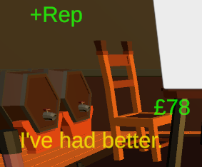
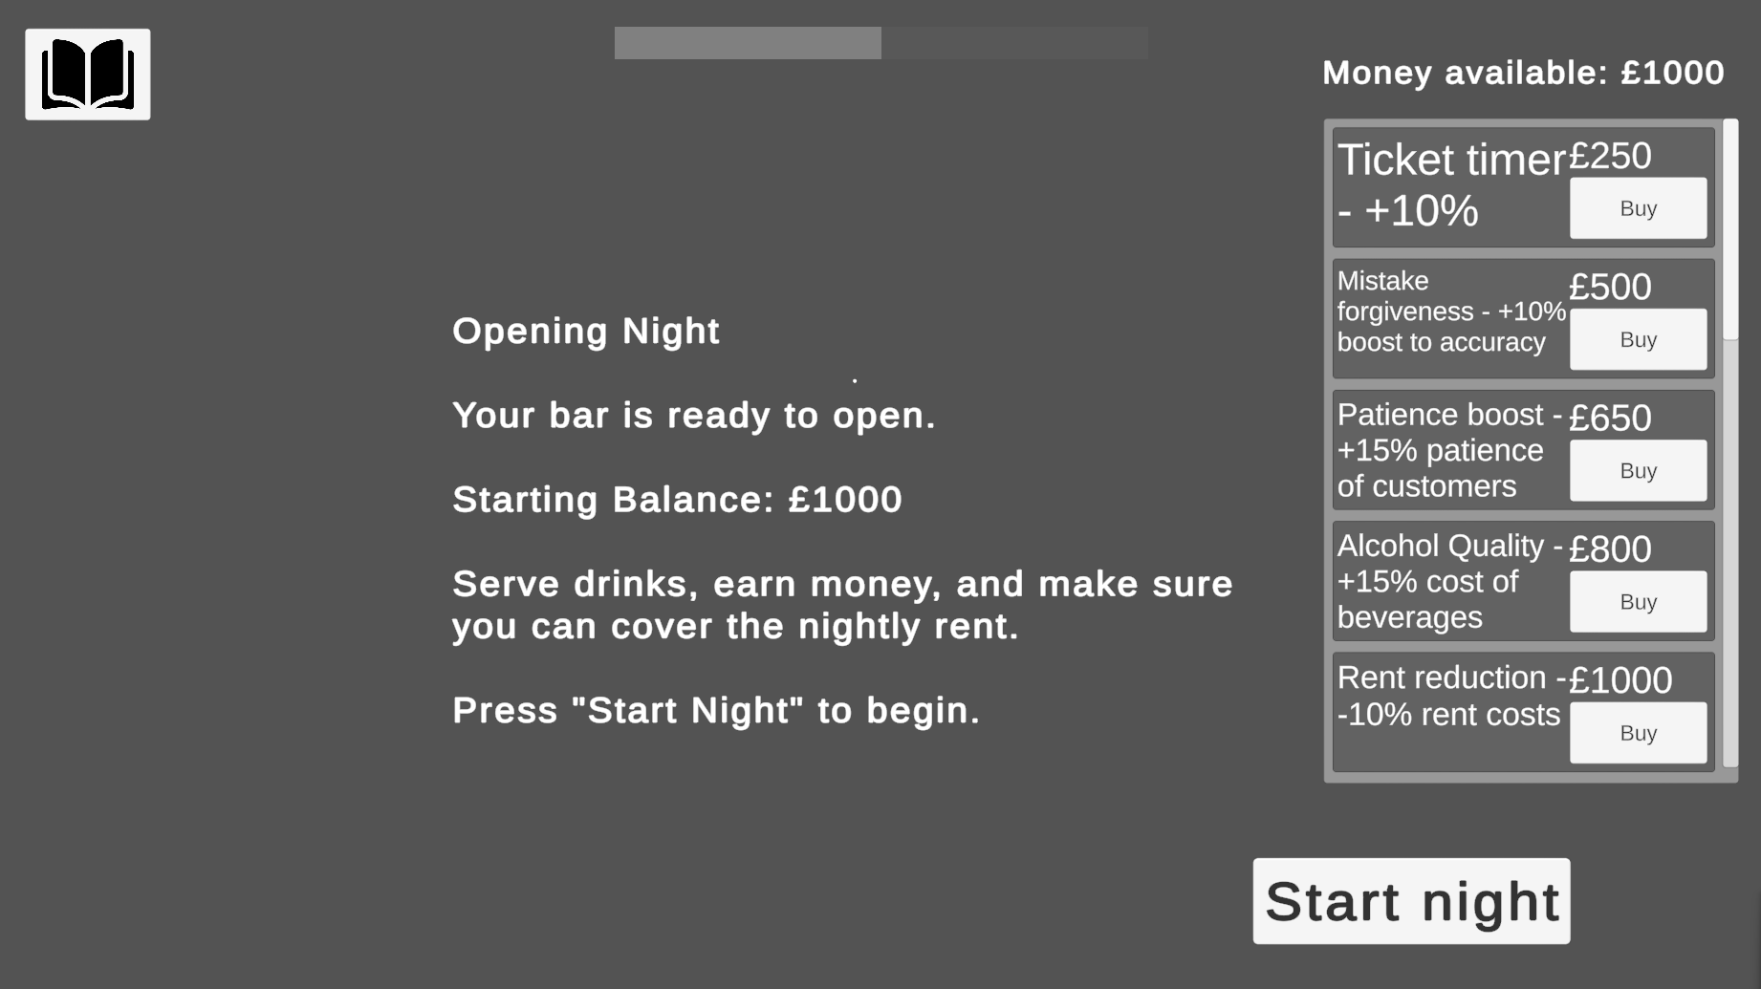
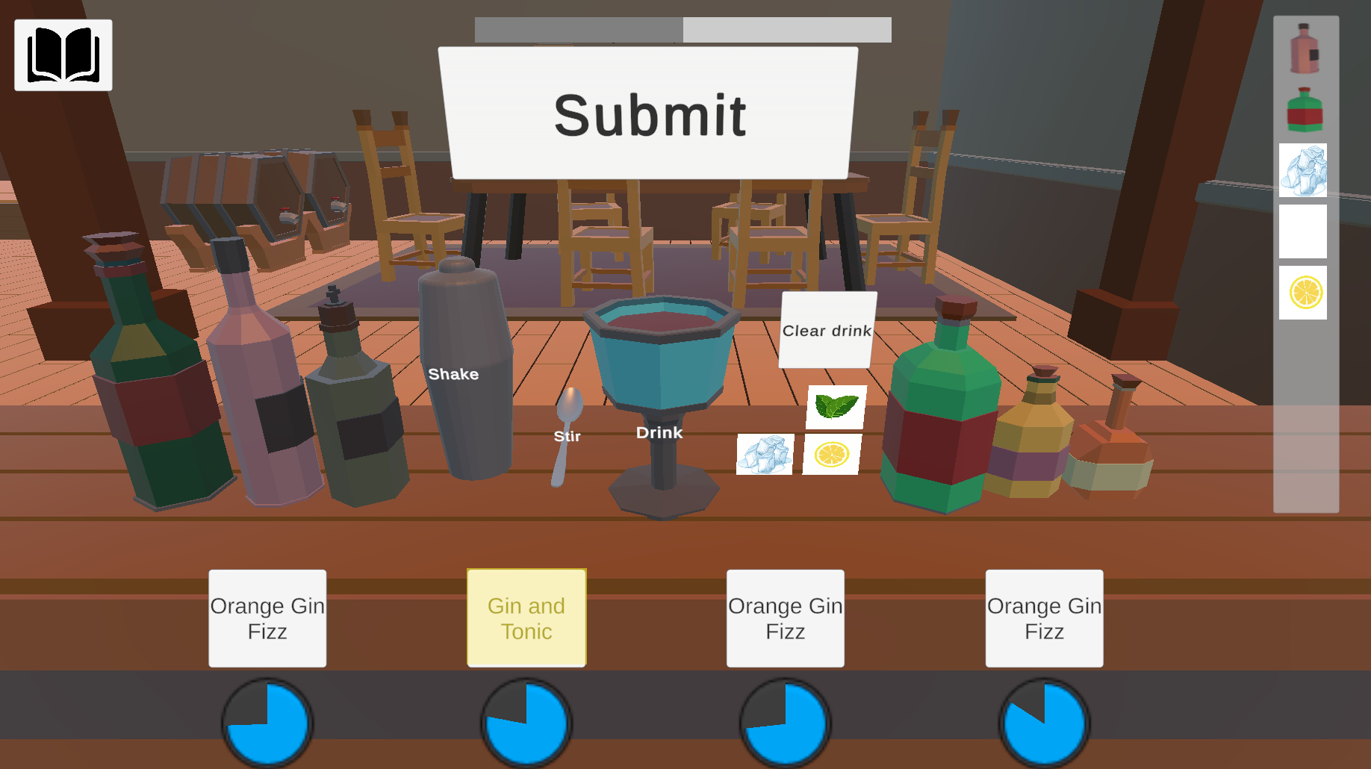
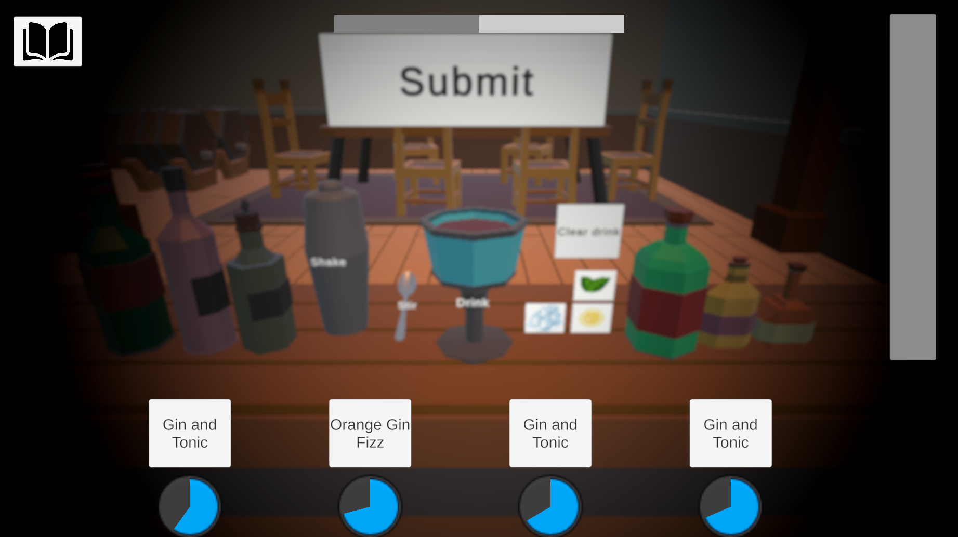
Last orders currently

Slide 5
Problem domain
Problem
Lack of skill-based systems that reward precision/timing
No meaningful feedback loop (like reputation) tied to performance
Limited player feedback, making it unclear how well the player is performing
Solution:
Implemented a skill-based cocktail creation system (timing, selection, accuracy)
Introduce a dynamic reputation system that rewards/punishes player performance
Provide clear visual and audio feedback
Competitors
Overcooked!
Bartender Simulator

Slide 6
The market
Target users – Casual players who enjoy simulation and management-style games and fans of short gameplay loops
Market size - Global games market exceeds $150+ billion annually
Popularity - Cooking/simulation games have strong engagement (Overcooked!), Rising interest in job simulation and “task satisfaction” games
Promotion strategy – Devlogs and progress updates, Short-form content

Slide 7
The prototype
Basic gameplay loop with simple player interactions and minimal recipes
Saw the need for more advanced interactions, a progression system tied to skill and feedback for the player
Made additional plans for a reputation system and FX text pop-ups with feedback to let the player gauge performance

Slide 8
MVP
Complete game-loop with some basic upgrades and a shake and stir interactions. 5 drink recipes with 9 ingredients.
Confirmed gameplay was enjoyable even with minimal content, needed some balancing for progression and FX in some places
Play tested more often to improve balance and sound effects added

Slide 9
MAP
Complete game-loop with 5 upgrade types.
5 drink recipes with 9 ingredients.
Player interaction of shake, stir and drag-drop for garnishes.
Feedback for player to know current performance. Recipe book for references to recipes
Ambient sound FX
Reset drink feature with additional FX and early closure

Slide 10
Next steps
Basic reputation system
UI polish
More FX (mainly sound)
More advanced progression system

Slide 11
Thanks Any questions?

